Slide 1
Understanding vector calculus

Slide 2
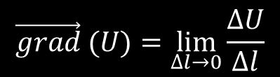
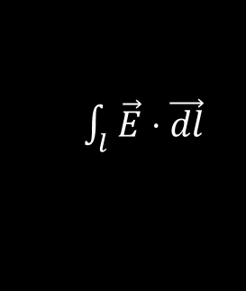


Points
$$∆U=U\left(B\right)−U(A)$$
$$\vec{grad} (U)=\lim_{∆l→0}{\frac{∆U}{∆l}}$$
$\int_{l}^{ }{\vec{E}⋅\vec{dl}}$
$\int_{l}^{ }{\vec{grad}(U)⋅\vec{dl}}=∆U$
Line

Slide 3

Closed line integral
$$\oint_{l}^{ }{\vec{E}⋅\vec{dl}}$$

Slide 4

Closed line integral of a gradient
$$\oint_{l}^{ }{\vec{grad}(U)⋅\vec{dl}}$$
$$=∆U$$
$$=0$$

Slide 5
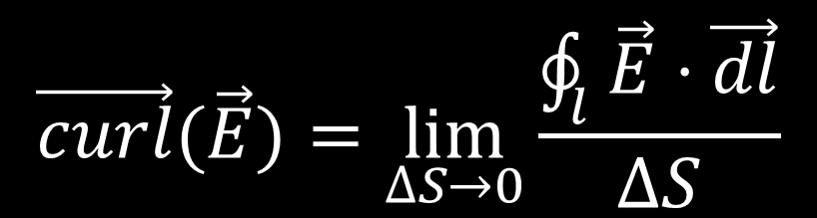
Curl
$$\vec{curl}(\vec{E})=\lim_{∆S→0}{\frac{\oint_{l}^{ }{\vec{E}⋅\vec{dl}}}{∆S}}$$

Slide 6



Curl
$$dy$$
$$dx$$
$${\vec{curl}}_{z}\left(\vec{E}\right)$$
=$\lim_{dxdy→0}{\frac{E_{x}dx+E_{y}\left(x+dx\right)dy −E_{x}\left(y+dy\right)dx −E_{y}dy}{dxdy}}$
=$\lim_{dxdy→0}{\frac{E_{y}\left(x+dx\right)dy−E_{y}dy}{dxdy}−\frac{E_{x}\left(y+dy\right)dx−E_{x}dx}{dydx}}$
=$\frac{∂E_{y}}{∂x}−\frac{∂E_{x}}{∂y}$

Slide 7
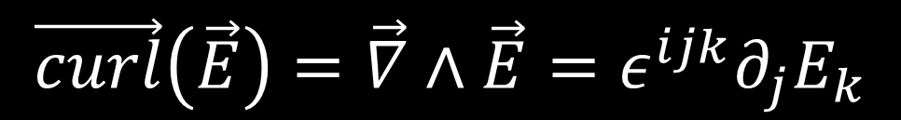


Curl
$$\vec{curl}(\vec{E})=\lim_{∆S→0}{\frac{\oint_{l}^{ }{\vec{E}⋅\vec{dl}}}{∆S}}$$
$$dy$$
$$dx$$
$$\vec{curl}\left(\vec{E}\right)=\vec{∇}∧\vec{E}=ε^{ijk}∂_{j}E_{k}$$
Curl is a tensor of rank N-2!!!

Slide 8

Curl of a gradient
$$\vec{curl}\left(\vec{grad}\left(U\right)\right) \\ =\lim_{∆S→0}{\frac{\oint_{l}^{ }{\vec{grad}\left(U\right)}}{∆S}}$$
$$=0$$
$$dy$$
$$dx$$

Slide 9



Potential of a curl-free field
$$\vec{curl}\left(\vec{E}\right)=0 ∮\vec{E}⋅\vec{dl}=0 \\ U\left(P\right)≡\int_{O}^{P}{\vec{E}⋅\vec{dl} }+U(O)$$
$$ΔU=∫\vec{E}⋅\vec{dl}=∫\vec{grad}(U)⋅\vec{dl}$$
$$\vec{E} =\vec{grad}(U)$$
$$P$$
$$O$$

Slide 10


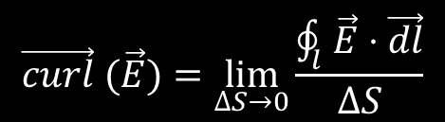
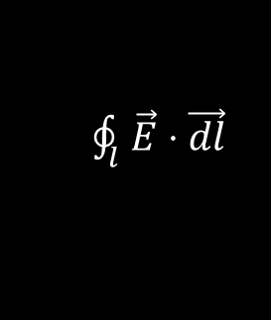
Points
Closed line
$$∆U=U\left(B\right)−U(A)$$
$\oint_{l}^{ }{\vec{E}⋅\vec{dl}}$
$$\vec{grad} (U)=\lim_{∆l→0}{\frac{∆U}{∆l}}$$
$$\vec{curl} (\vec{E})=\lim_{∆S→0}{\frac{\oint_{l}^{ }{\vec{E}⋅\vec{dl}}}{∆S}}$$
$\oint_{l}^{ }{\vec{grad}(U)⋅\vec{dl}}=0$
$\vec{E}=\vec{grad}(U)$ <-> $\vec{curl}(\vec{E})=0$
$\int_{l}^{ }{\vec{E}⋅\vec{dl}}$
$\int_{l}^{ }{\vec{grad}(U)⋅\vec{dl}}=∆U$
Line

Slide 11

Surface integral
$$\iint_{S}^{ }{\vec{E}⋅\vec{dS}}=\lim_{dS→0}{\sum{\vec{E}⋅\vec{dS}}}$$

Slide 12

Surface integral of a curl
$$\iint_{S}^{ }{\vec{curl} (\vec{E})⋅\vec{dS}}=$$
$$=\lim_{∆S→0}{\sum{\frac{\oint{\vec{E}}⋅\vec{dl}}{∆S}⋅\vec{∆S}}}$$
$$=\sum{\oint{\vec{E}}⋅\vec{dl}}$$
$=$ $\oint{\vec{E}}⋅\vec{dl}$

Slide 13


Points
Closed line
$$∆U=U\left(B\right)−U(A)$$
$\oint_{l}^{ }{\vec{E}⋅\vec{dl}}$
$$\vec{grad} (U)=\lim_{∆l→0}{\frac{∆U}{∆l}}$$
$$\vec{curl} (\vec{E})=\lim_{∆S→0}{\frac{\oint_{l}^{ }{\vec{E}⋅\vec{dl}}}{∆S}}$$
$\oint_{l}^{ }{\vec{grad}(U)⋅\vec{dl}}=0$
$\vec{E}=\vec{grad}(U)$ <-> $\vec{curl}(\vec{E})=0$
$\int_{l}^{ }{\vec{E}⋅\vec{dl}}$
$\iint_{S}^{ }{\vec{E}⋅\vec{dS}}$
$\int_{l}^{ }{\vec{grad}(U)⋅\vec{dl}}=∆U$
$\iint_{S}^{ }{\vec{curl}(\vec{E})⋅\vec{dS}}=\oint_{l}^{ }{\vec{E}⋅\vec{dl}}$
Line
Surface

